Slide 1
FACIAL VIDEO FORGERY DETECTION
Under the esteemed guidance of:
Mr. J. Madhan Kumar ,B.Tech, M.Tech (Ph.D)
Asst.Professor , CSE Department
Presented by,
Batch-C18
Y.Srinivas (Y20ACS590)
N.Manidhar (L21ACS413)
P.Subramanyam (L21ACS419)
R. Sivanaga Laxmi (L21ACS416)
-

Slide 2
Table of Contents
Abstract
Existing System
Proposed System
Design
Implementation
Result
Conclusion

Slide 3
Abstract:
This efficiently detect face tampering in videos, and particularly focuses on two recent techniques used to generate hyper-realistic forged videos: Deepfake and Face2Face.
It follows a deep learning approach and presents two networks, both with a low number of layers to focus on the mesoscopic properties of images.
For forgery video detection using two networks by implementing Convolutional Neural Networks(CNN).

Slide 4
Existing System:
Approaches:
MesoNet and its types Meso-4 and MesoInception-4
The forgery detection using MesoNet contains both CNN and RNN.
Limitations:
Facial video forgery detection faces challenges in keeping pace with evolving forgery techniques, resource-intensive computations, and balancing the trade-off between false positives and negatives.
Challenges :
We are detecting the forgeries of faces in videos created by using both Deepfake and Face2Face using only CNN.

Slide 5
Proposed System:
The Proposed system for Facial video forgery detection is using Convolutional Neural Networks(CNN ) in MesoNet network. It is only one used for detecting forgery videos created by using both Deepfake and Face2Face.
Four layers were used contains pooling, RELU activation functions, convolutions.
Layers of convolutions and pooling for feature extraction and a dense network for classification.
Meso-4
MesoInception-4

Slide 6
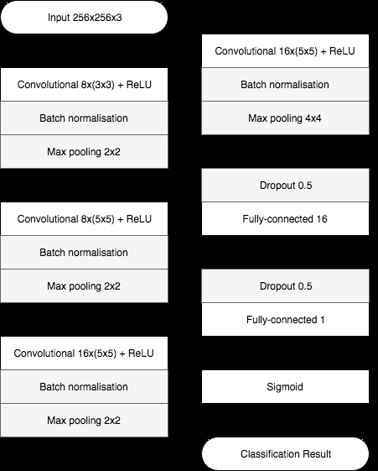
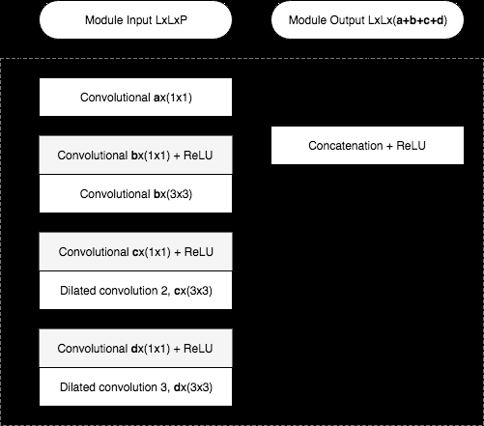
DESIGN
MESO-4
MESOINCEPTION-4

Slide 7
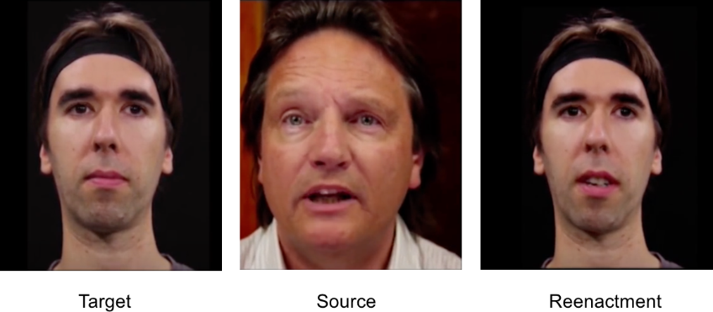
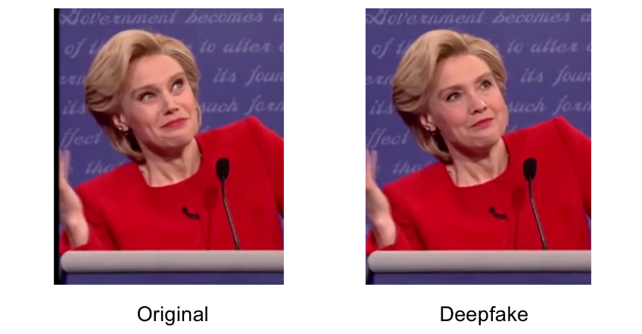
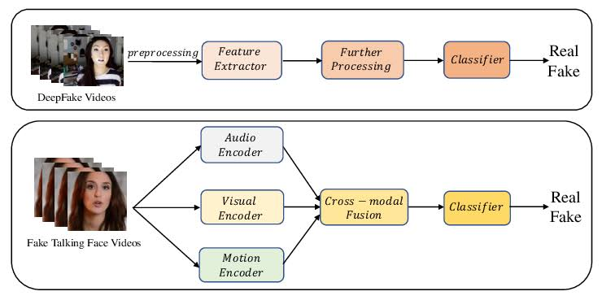
Implementation:

Slide 8
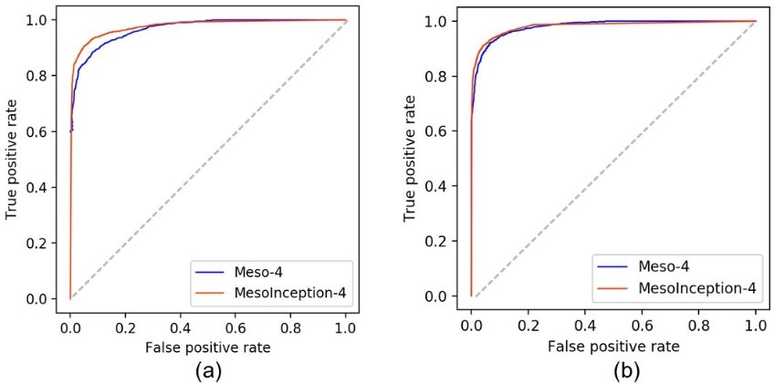
Set | Forged class | Real Class
Deep fake Training | 5111 | 7250
Deep fake Testing | 2889 | 4259
Face2Face Training | 4500 | 4500
Face2Face Testing | 3000 | 3000
Network | Face2Face | Classificatio n | score
Compression level | 0 | 23 light | 40 Strong
Meso-4 | 0.946 | 0.924 | 0.832
Meso Inseptio n-4 | 0.968 | 0.934 | 0.813

Slide 9

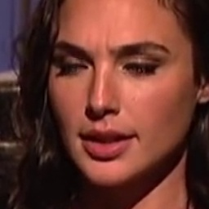
Result: Real Real

Slide 10
Classifier prediction 1:
1/1[==============================]-0s 251ms/step Predicted : [[0.99556977]] Real class : [0.]
Classifier Accuracy 1:
[0.9911591410636902, 0.0]

Slide 11
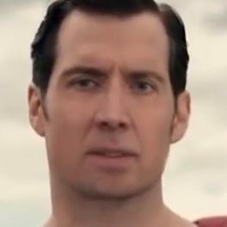

Deep Fake Real

Slide 12
Classifier Prediction 2:
1/1[==============================]-0s 148ms/step Predicted : [[0.9978207]] Real class : [1.]
Classifier Accuracy 2:
[4.749455911223777e-06, 1.0]

Slide 13
Conclusion
One of the key conclusions drawn from current research is the necessity for a multi-faceted approach to detection, combining traditional methods with cutting-edge deep learning techniques.
By leveraging a combination of facial landmarks analysis, texture analysis, motion detection, and deep neural network architectures, researchers have achieved promising results in identifying manipulated facial videos.
Additionally, the utilization of large-scale datasets and continuous model refinement are crucial for improving detection accuracy and robustness against emerging threats.

Slide 14


